Slide 1
CS209: Computer Science II

Slide 2
Unit 3 Module 5:
Binary Trees
Introducing Binary Trees
Binary Tree Terminology
Binary Tree Structure
Binary Tree Operations
Template Considerations and coding examples for Binary Search Trees

Slide 3
Definition of a Binary Tree
A binary tree is made up of a finite set of nodes that is
either empty or consists of a node called the root
together with two binary trees, called the left and right
subtrees, which are disjoint from each other and from
the root.

Slide 4
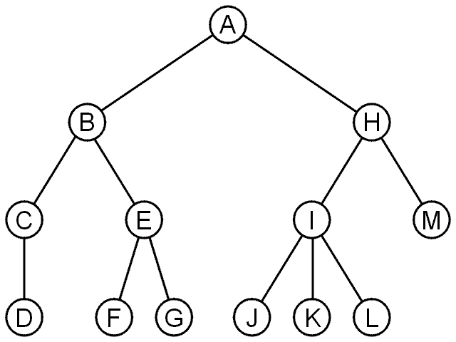
Trees
A rooted tree data structure stores information in nodes
Similar to linked lists:
There is a first node, or root
Each node has variable number of references to successors
Each node, other than the root, has exactly one node pointing to it

Slide 5
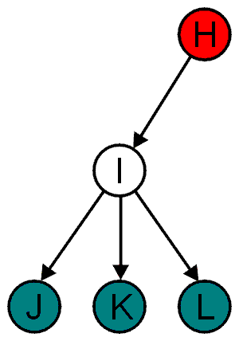
Terminology
All nodes will have zero or more child nodes or children
I has three children: J, K and L
For all nodes other than the root node, there is one parent node
H is the parent I

Slide 6
Terminology
The degree of a node is defined as the number of its children: deg(I) = 3
Nodes with the same parent are siblings
J, K, and L are siblings

Slide 7
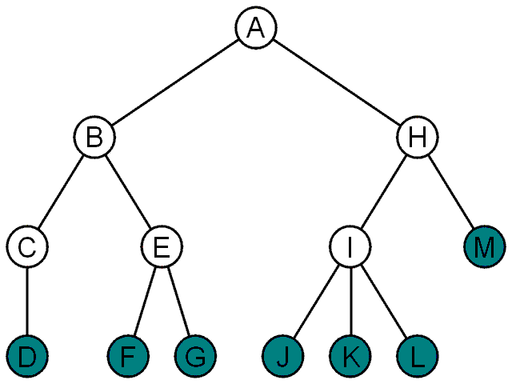
Terminology
Nodes with degree zero are also called leaf nodes
All other nodes are said to be internal nodes, that is, they are internal to the tree

Slide 8
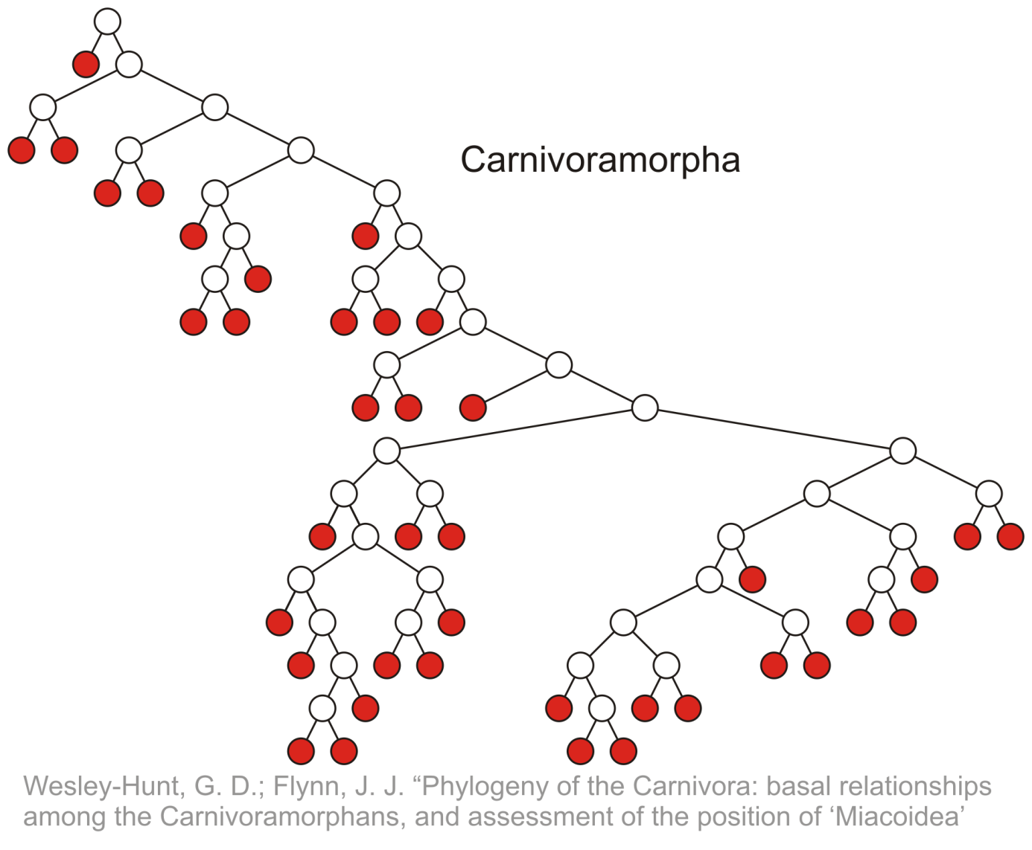
Terminology
Leaf nodes:

Slide 9
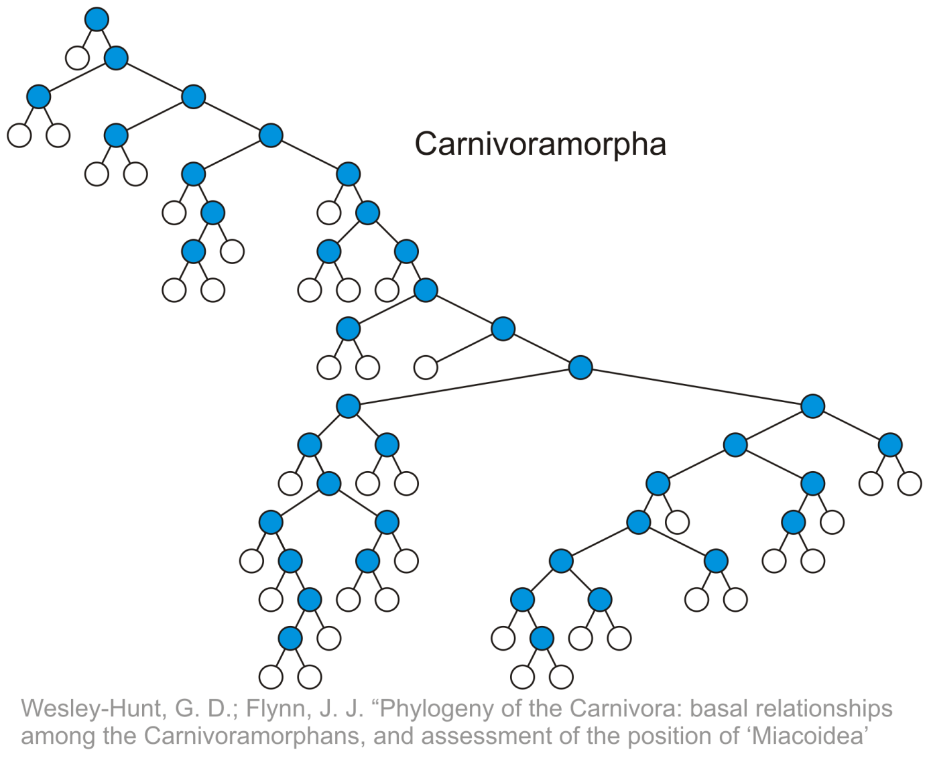
Terminology
Internal nodes:

Slide 10
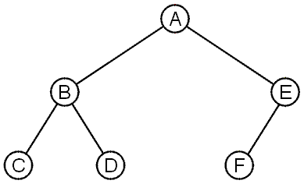
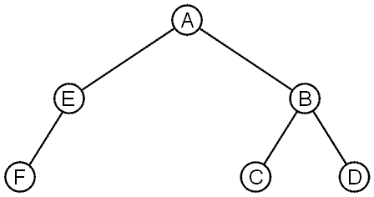
Terminology
These trees are equal if the order of the children is ignored
unordered trees
They are different if order is relevant (ordered trees)
We will usually examine ordered trees (linear orders)
In a hierarchical ordering, order is not relevant

Slide 11
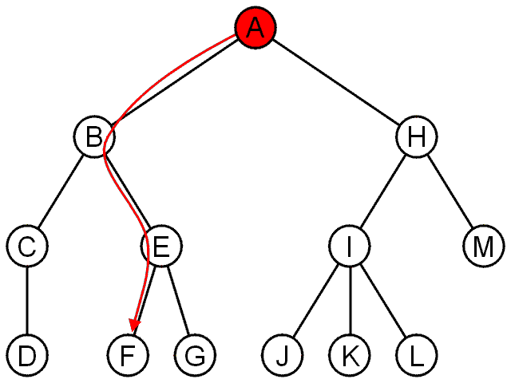
Terminology
The shape of a rooted tree gives a natural flow from the root node, or just root

Slide 12
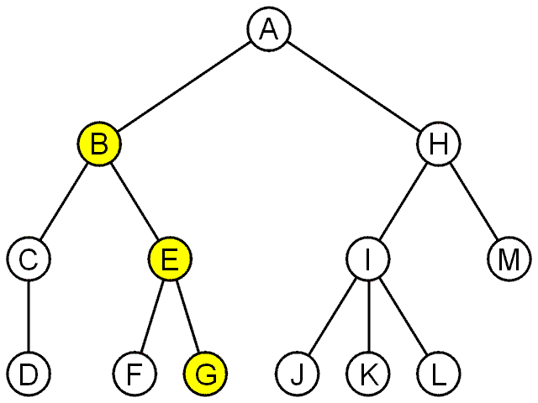
Terminology
A path is a sequence of nodes
(a₀, a₁, ..., a_{n})
where a_{k + 1} is a child of a_{k} is
The length of this path is n
E.g., the path (B, E, G) has length ?

Slide 13
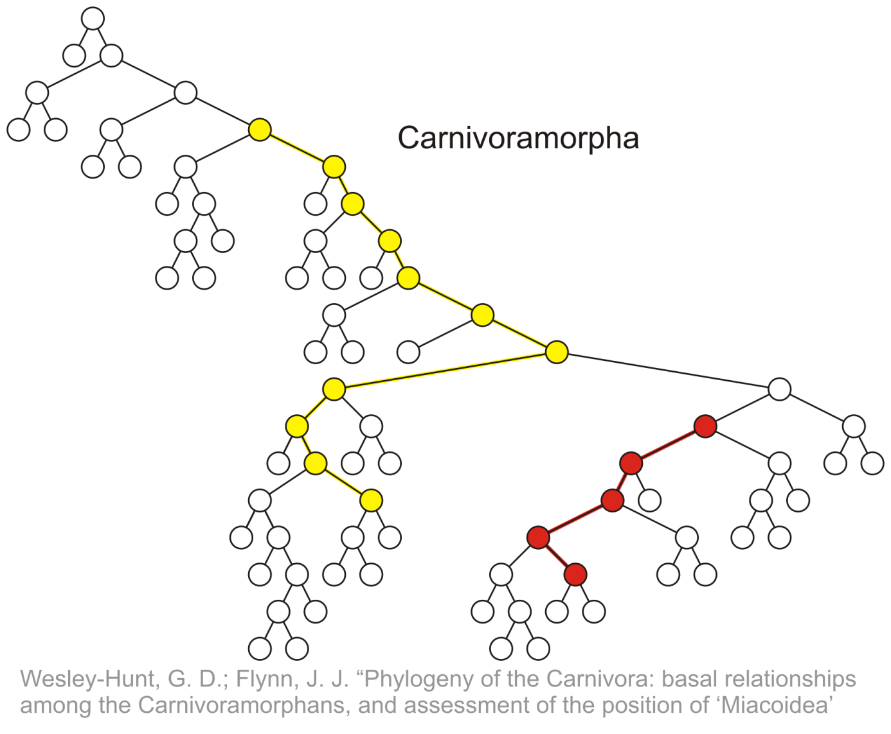
Terminology
Paths of length 10 (11 nodes) and 4 (5 nodes)
Start of these paths
End of these paths

Slide 14
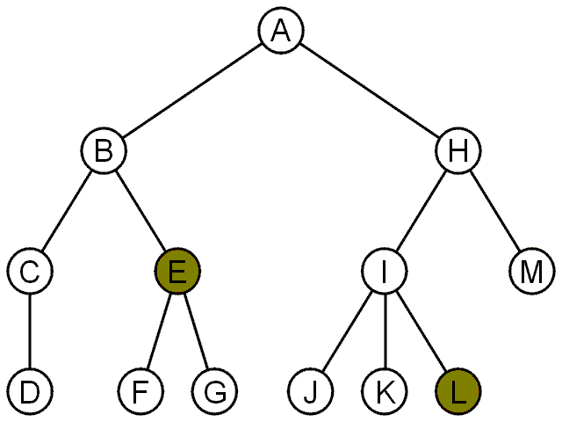
Terminology
For each node in a tree, there exists a unique path from the root node to that node
The length of this path is the depth of the node, e.g.,
E has depth 2
L has depth 3

Slide 15
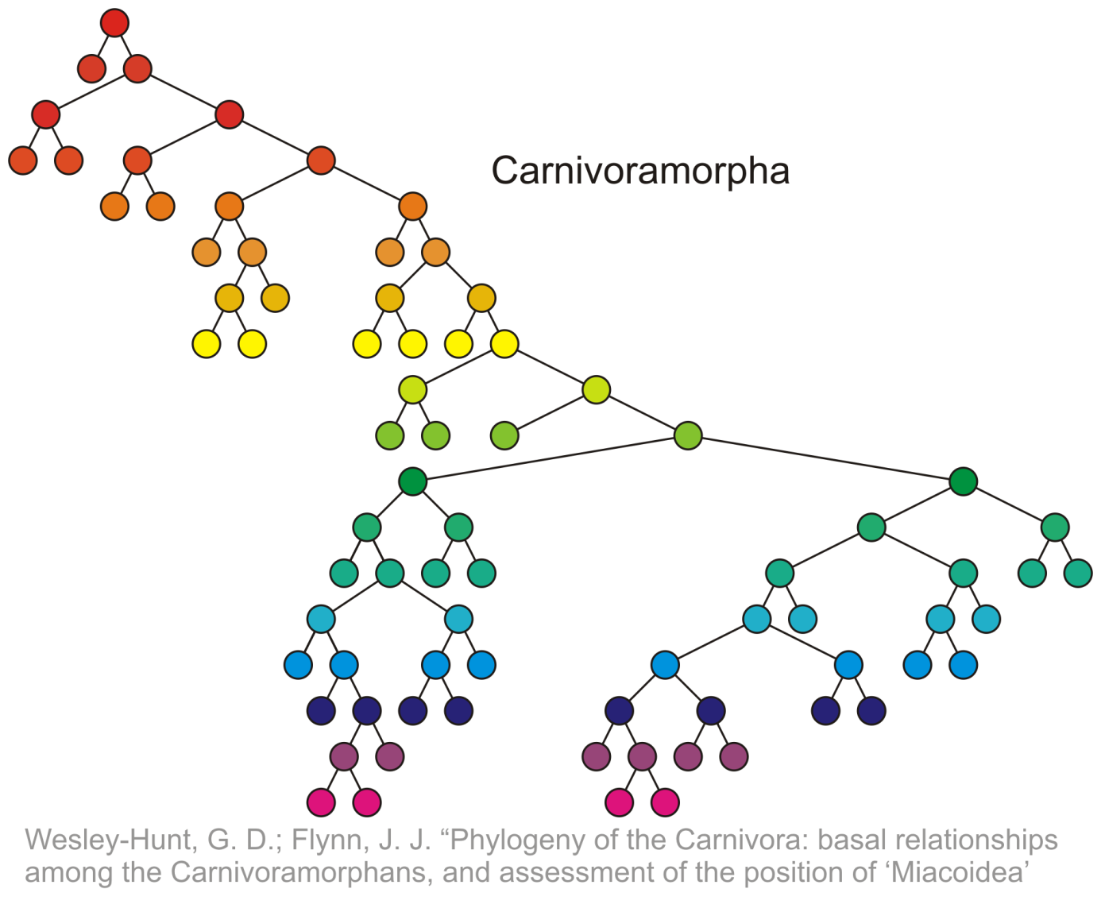
Terminology
Nodes of depth up to 17
0
4
9
14
17

Slide 16
Terminology
The height of a tree is defined as the maximum depth of any node within the tree
The height of a tree with one node is 0
Just the root node
For convenience, we define the height of the empty tree to be –1

Slide 17
Terminology
The height of this tree is 17
17

Slide 18
Terminology
If a path exists from node a to node b:
a is an ancestor of b
b is a descendent of a
Thus, a node is both an ancestor and a descendant of itself
We can add the adjective strict to exclude equality: a is a strict descendent of b if a is a descendant of b but a ≠ b
The root node is an ancestor of all nodes

Slide 19
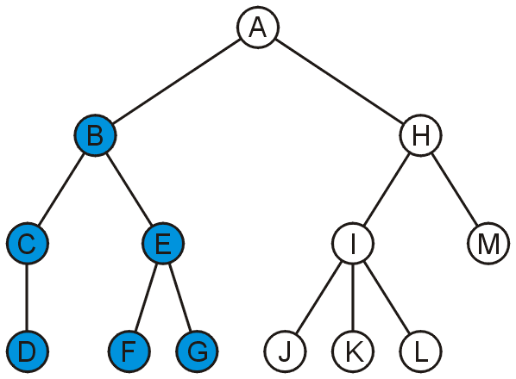
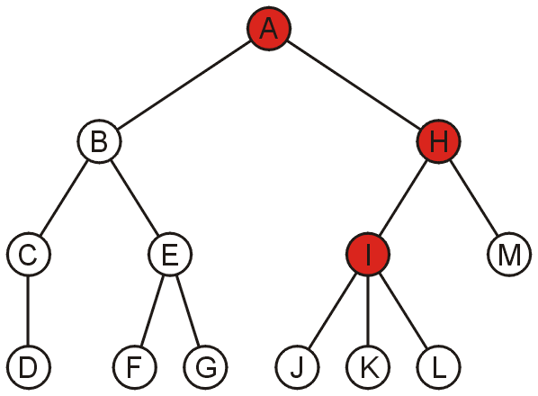
Terminology
The descendants of node B are B, C, D, E, F, and G:
The ancestors of node I are I, H, and A:

Slide 20
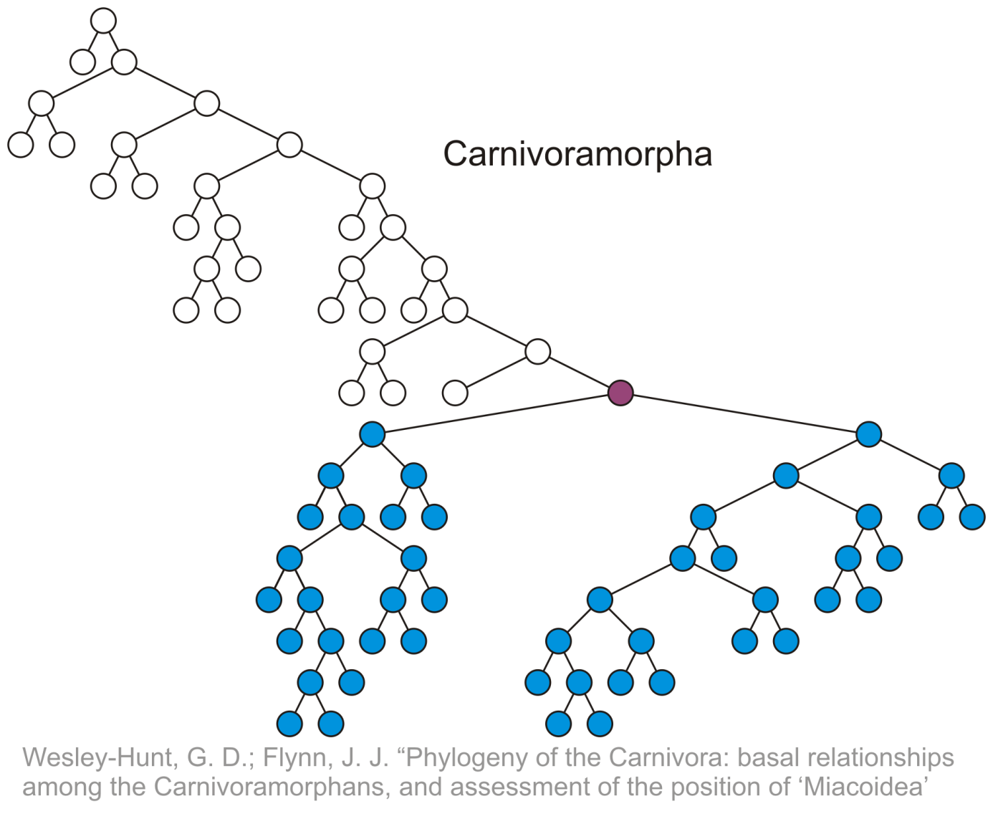
Terminology
All descendants (including itself) of the indicated node

Slide 21
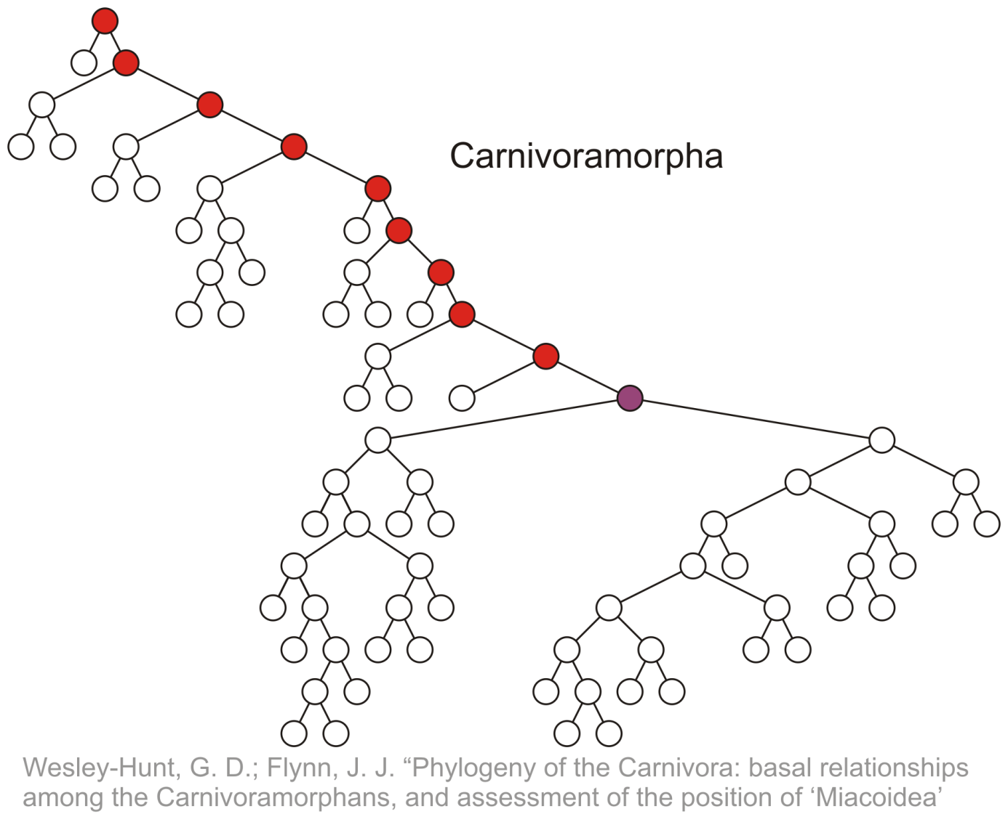
Terminology
All ancestors (including itself) of the indicated node

Slide 22
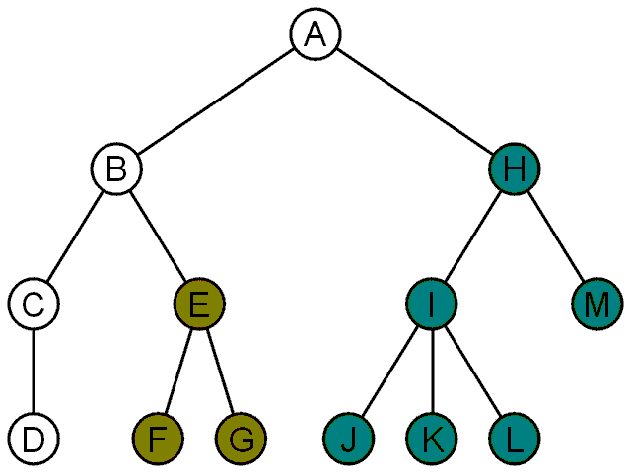
Terminology
Another approach to a tree is to define the tree recursively:
A degree-0 node is a tree
A node with degree n is a tree if it has n children and all of its children are disjoint trees (i.e., with no intersecting nodes)
Given any node a within a tree with root r, the collection of a and all of its descendants is said to be a subtree of the tree with root a

Slide 23
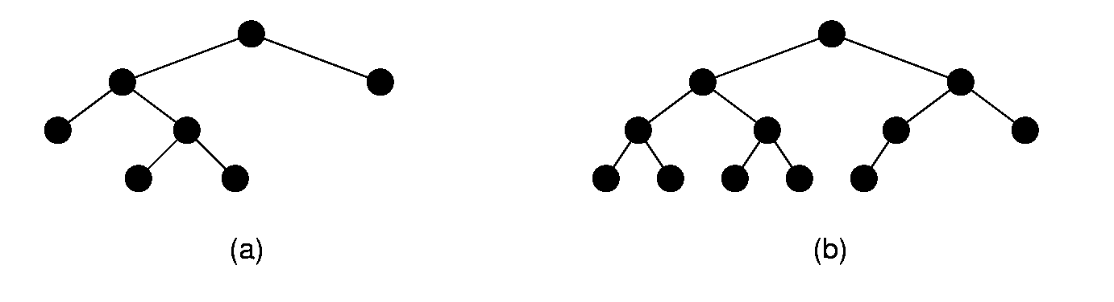
Full and Complete Binary Trees
Full binary tree: Each node is either a leaf or internal node with exactly two non-empty children.
Complete binary tree: If the height of the tree is d, then all leaves except possibly level d are completely full. The bottom level has all nodes to the left side.

Slide 24
Definition and Application of Binary Trees
Binary tree: a nonlinear linked list in which each node may point to 0, 1, or two other nodes
Each node contains
one or more
data fields and
two pointers
null
null
null
null
null
null

Slide 25
Binary Tree Structuring
Tree pointer: like a head pointer for a linked list, it points to the first node in the binary tree
Root node: the node at the top of the tree
null
null
null
null
null
null

Slide 26
Binary Tree Structuring
Leaf nodes: nodes that have no children
The nodes containing 7 and 43 are leaf nodes
31
19
59
7
null
43
null
null
null
null
null

Slide 27
Binary Tree Structuring
Child nodes, children: nodes below a given node
The children of the node containing 31 are the nodes containing 19 and 59
31
19
59
7
null
43
null
null
null
null
null

Slide 28
Binary Tree Structuring
Parent node: node above a given node
The parent of the node containing 43 is the node containing 59
31
19
59
7
null
43
null
null
null
null
null

Slide 29
Binary Tree Structuring
Subtree: the portion of a tree from a node down to the leaves
The nodes containing 19 and 7 are the left subtree of the node containing 31
31
19
59
7
null
43
null
null
null
null
null

Slide 30
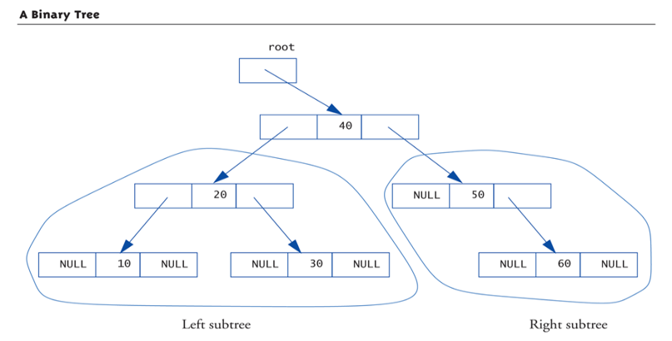
Tree Structure: A Binary Tree (1 of 2)

Slide 31
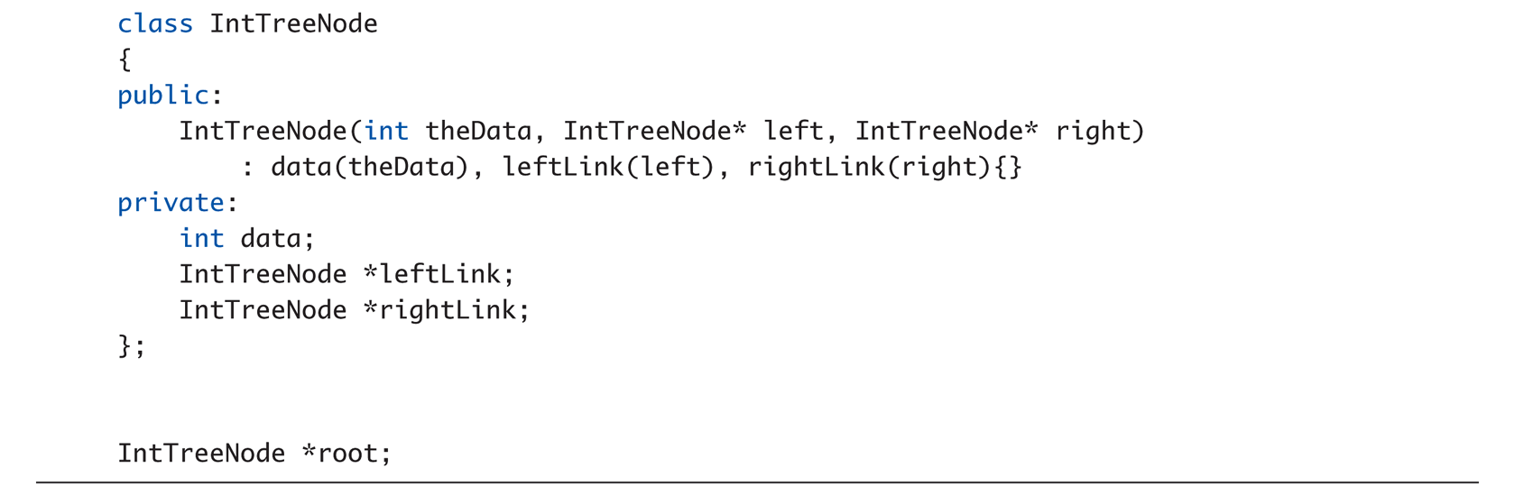
Tree Structure: A Binary Tree (2 of 2)

Slide 32
Uses of Binary Trees
Binary search tree: data organized in a binary tree to simplify searches
Left subtree of a node contains data values < the data in the node
Right subtree of a node contains values > the data in the node
31
19
59
7
null
43
null
null
null
null
null

Slide 33
Searching in a Binary Tree
Start at root node
Examine node data:
Is it desired value? Done
Else, is desired data < node data? Repeat step 2 with left subtree
Else, is desired data > node data? Repeat step 2 with right subtree
Continue until desired value found or a null pointer reached
31
19
59
7
null
43
null
null
null
null
null

Slide 34
Searching in a Binary Tree
To locate the node containing 43,
Examine the root node (31) first
Since 43 > 31, examine the right child of the node containing 31, (59)
Since 43 < 59, examine the left child of the node containing 59, (43)
The node containing 43 has been found
31
19
59
7
null
43
null
log₂n iterations
null
null
null
null

Slide 35
Cost of BST compared
 | Unsorted Array | Linked List | Sorted Array | BST
log₂n iterations

Slide 36
Cost of BST compared
 | Unsorted Array | Linked List | Sorted Array | BST
Search (n) | O(n)
Insert (n) | O(1)
Delete (n) | O(n)
log₂n iterations

Slide 37
Cost of BST compared
 | Unsorted Array | Linked List | Sorted Array | BST
Search (n) | O(n) | O(n)
Insert (n) | O(1) | O(1)
Delete (n) | O(n) | O(n)
log₂n iterations

Slide 38
Cost of BST compared
 | Unsorted Array | Linked List | Sorted Array | BST
Search (n) | O(n) | O(n) | O(Logn)
Insert (n) | O(1) | O(1) | O(n)
Delete (n) | O(n) | O(n) | O(n)
log₂n iterations

Slide 39
Cost of BST compared
 | Unsorted Array | Linked List | Sorted Array | BST
Search (n) | O(n) | O(n) | O(Logn) | O(Logn)
Insert (n) | O(1) | O(1) | O(n) | O(Logn)
Delete (n) | O(n) | O(n) | O(n) | O(Logn)
log₂n iterations

Slide 40
Binary Search Tree Operations
Create a binary search tree – organize data into a binary search tree
Insert a node into a binary tree – put node into tree in its correct position to maintain order
Find a node in a binary tree – locate a node with particular data value
Delete a node from a binary tree – remove a node and adjust links to maintain binary tree

Slide 41
Binary Search Tree Node
A node in a binary tree is like a node in a linked list, with two node pointer fields:
struct TreeNode
{
int value;
TreeNode *left;
TreeNode *right;
}

Slide 42
Creating a New Node
newNode
Allocate memory for new node:
newNode = new TreeNode;
Initialize the contents of the node:
newNode->value = num;
Set the pointers to nullptr:
newNode->Left
= newNode->Right
= nullptr;
newNode
23
newNode
23
null
null

Slide 43
Inserting a Node in a Binary Search Tree
If tree is empty, insert the new node as the root node
Else, compare new node against left or right child, depending on whether data value of new node is < or > root node
Continue comparing and choosing left or right subtree until null pointer found
Set this null pointer to point to new node

Slide 44
Inserting a Node in a Binary Search Tree
newNode
Examine this node first – value is < node, so go to left subtree
root
23
Examine this node second – value is > node, so go to right subtree
null
null
31
19
59
7
null
43
null
null
null
null
null
Since the right subtree is null, insert here

Slide 45
Traversing a Binary Tree
Three traversal methods:
Inorder:
Traverse left subtree of node
Process data in node
Traverse right subtree of node
Preorder:
Process data in node
Traverse left subtree of node
Traverse right subtree of node
Postorder:
Traverse left subtree of node
Traverse right subtree of node
Process data in node

Slide 46
Tree Processing
Preorder Processing:
Process data in root node
Process left subtree
Process right subtree
In-order Processing:
Process left subtree
Process data in root
Process right subtree
Postorder Processing:
Process left subtree
Process right subtree
Process data in root

Slide 47
Traversing a Binary Tree
TRAVERSAL METHOD | NODES VISITED IN ORDER
Inorder | 7, 19, 31, 43, 59
Preorder | 31, 19, 7, 59, 43
Postorder | 7, 19, 43, 59, 31
31
19
59
7
null
43
null
null
null
null
null

Slide 48
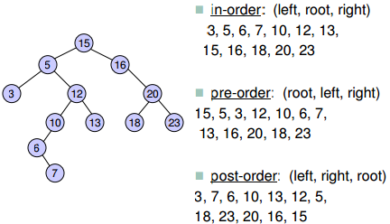
Traversing a Binary Tree

Slide 49
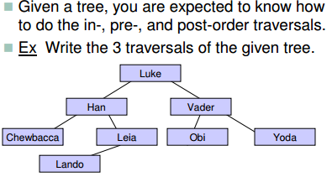

Traversing a Binary Tree

Slide 50
Tree Storage
Our example stored values in special way:
Called binary search tree storage rule:
values in left subtree less than root value
values in right subtree greater than root
rule applies recursively to each subtree
Trees using this storage mechanism:
Called binary search tree (BST)
Traversals: Inorder → values "in order" Preorder → "prefix" notation Postorder → "postfix" notation

Slide 51
Searching in a Binary Tree
Start at root node, traverse the tree looking for value
Stop when value found or null pointer detected
Can be implemented as a bool function
31
19
59
7
null
43
null
null
null
null
null
Search for 43? return true
Search for 17? return false

Slide 52
Deleting a Node from a Binary Tree – Leaf Node
If node to be deleted is a leaf node, replace parent node’s pointer to it with the null pointer, then delete the node
19
19
null
null
7
null
null
null
Deleting node with 7 – before deletion
Deleting node with 7 – after deletion

Slide 53
Deleting a Node from a Binary Tree – One Child
If node to be deleted has one child node, adjust pointers so that parent of node to be deleted points to child of node to be deleted, then delete the node

Slide 54
Deleting a Node from a Binary Tree – One Child
31
31
19
59
7
59
7
null
43
null
null
null
43
null
null
null
null
null
null
null
Deleting node with 19 – before deletion
Deleting node with 19 – after deletion

Slide 55
Deleting a Node from a Binary Tree – Two Children
If node to be deleted has left and right children,
‘Promote’ one child to take the place of the deleted node
Locate correct position for other child in subtree of promoted child
Convention in text: promote the right child, position left subtree underneath

Slide 56
Deleting a Node from a Binary Tree – Two Children
31
59
19
59
43
null
19
null
7
null
43
null
7
null
null
null
null
null
null
null
Deleting node with 31 – before deletion
Deleting node with 31 – after deletion

Slide 57
Template Considerations for Binary Search Trees
Binary tree can be implemented as a template, allowing flexibility in determining type of data stored
Implementation must support relational operators >, <, and == to allow comparison of nodes

Slide 58

Let’s code!

Slide 59
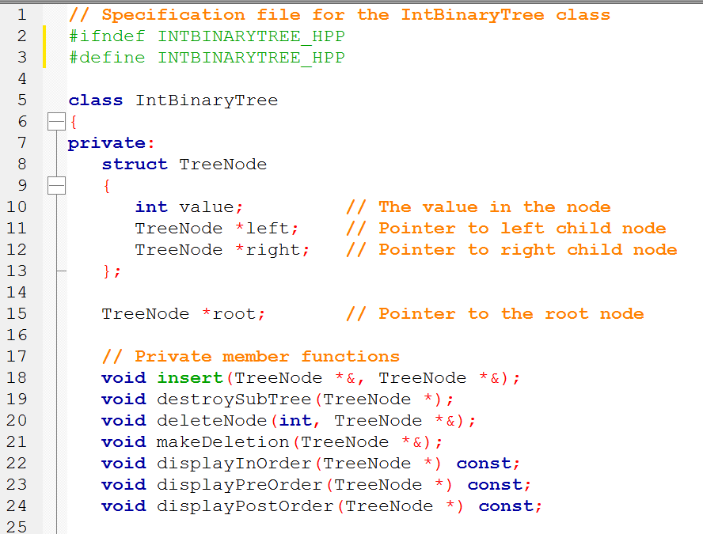

Slide 60
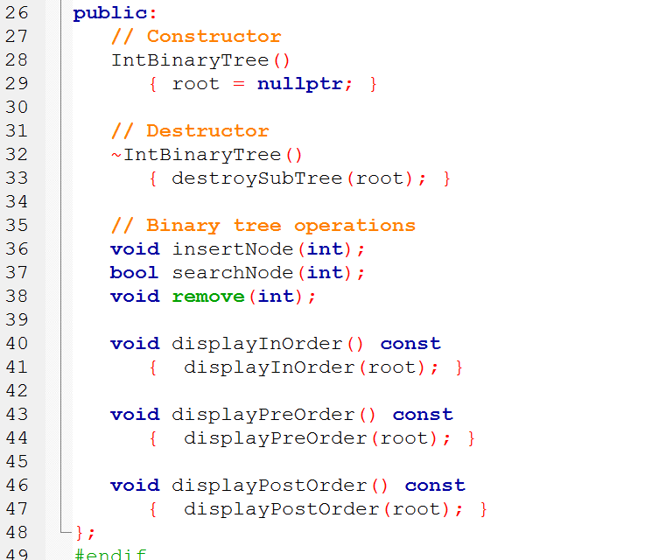
Well considered operations

Slide 61
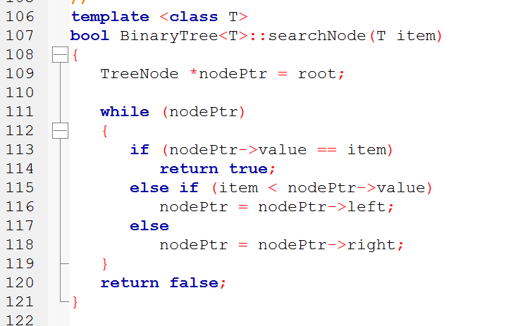

Slide 62
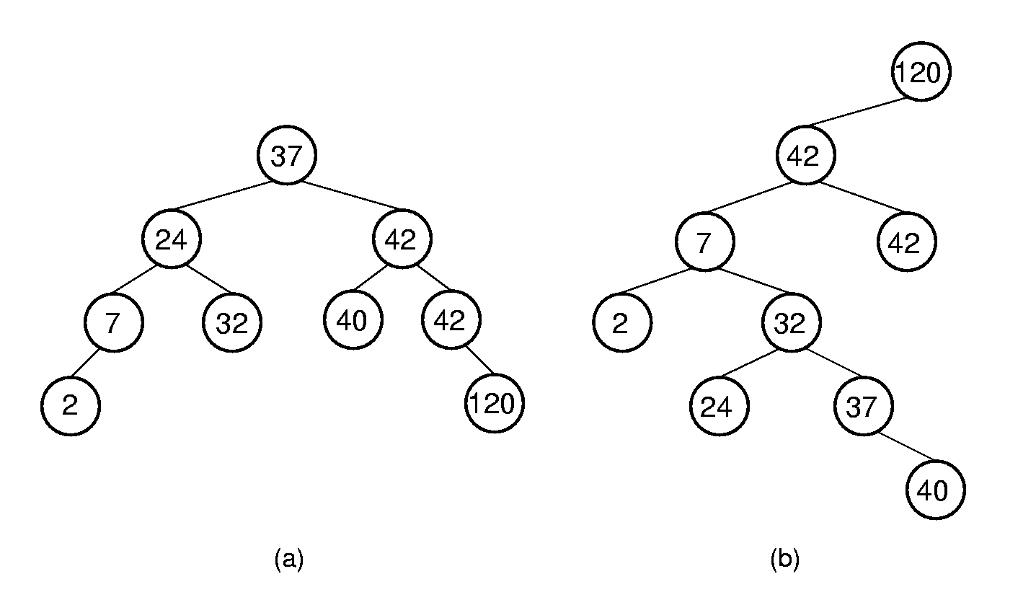
Binary Search Trees (BST)
BST Property: All elements stored in the left subtree of a node with value K have values < K. All elements stored in the right subtree of a node with value K have values >= K.

Slide 63
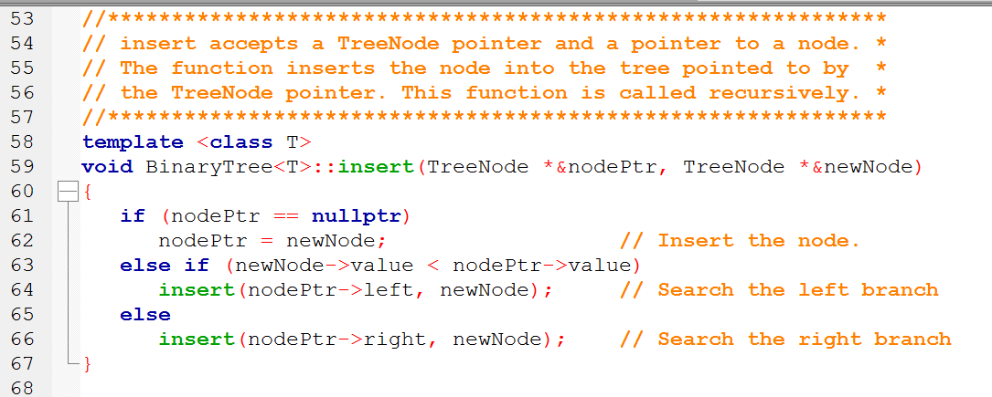
first checks to see if the value for root is NULL.

Slide 64
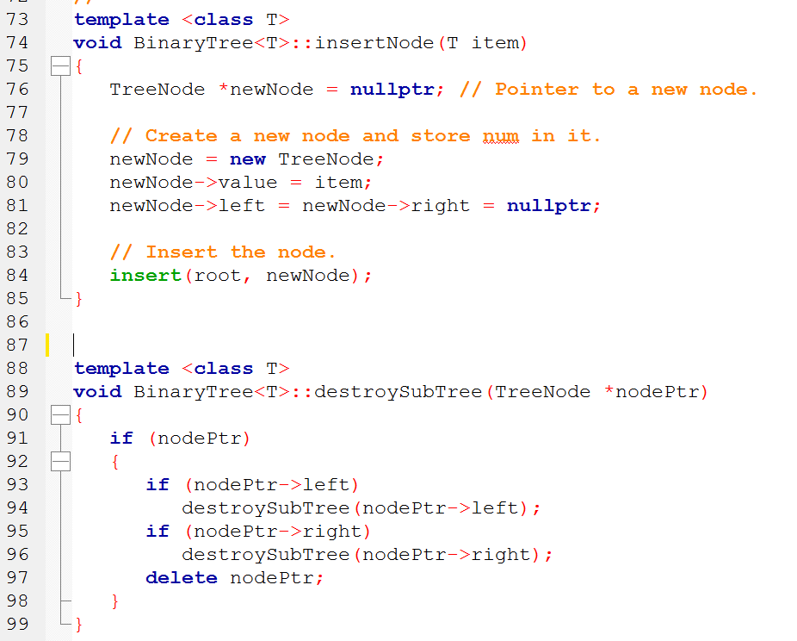
For clarity it could not be multi-assigned
If there’s a valid pointer on each side (if ptr)

Slide 65
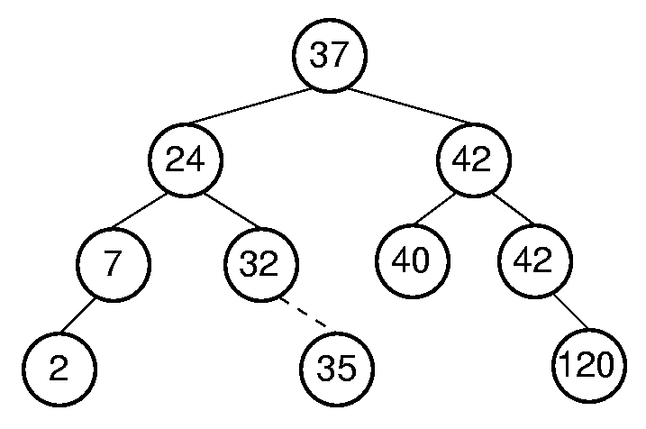
BST Insert

Slide 66
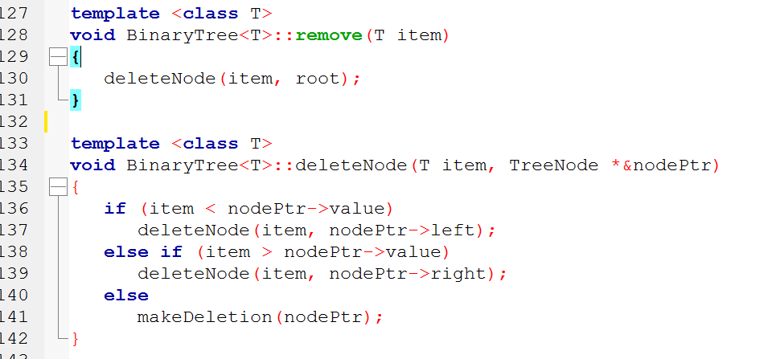
Maintain the BST property

Slide 67
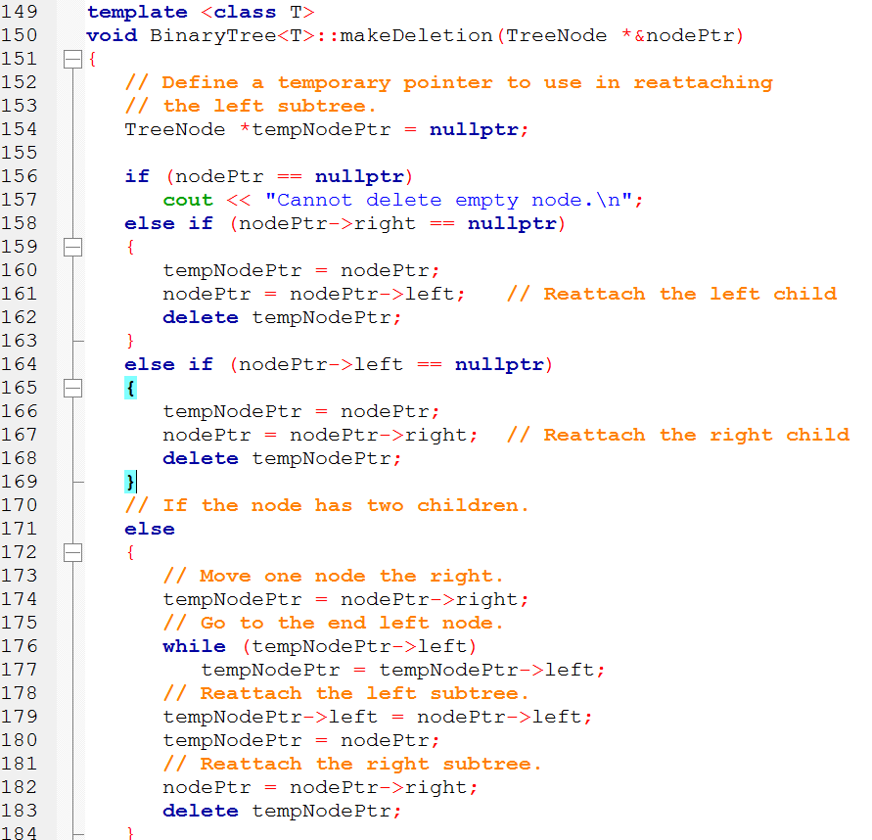
Is it left, right, or both?

Slide 68
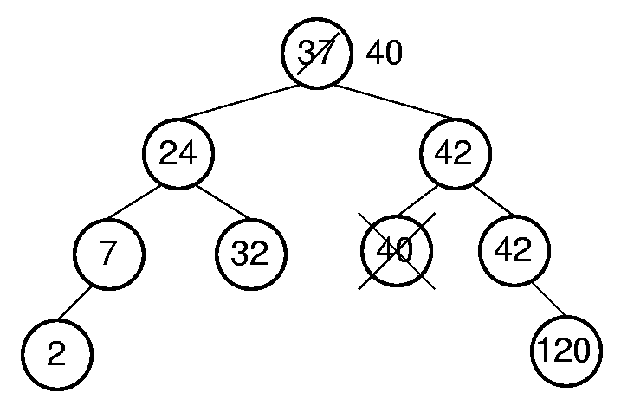
BST Remove

Slide 69
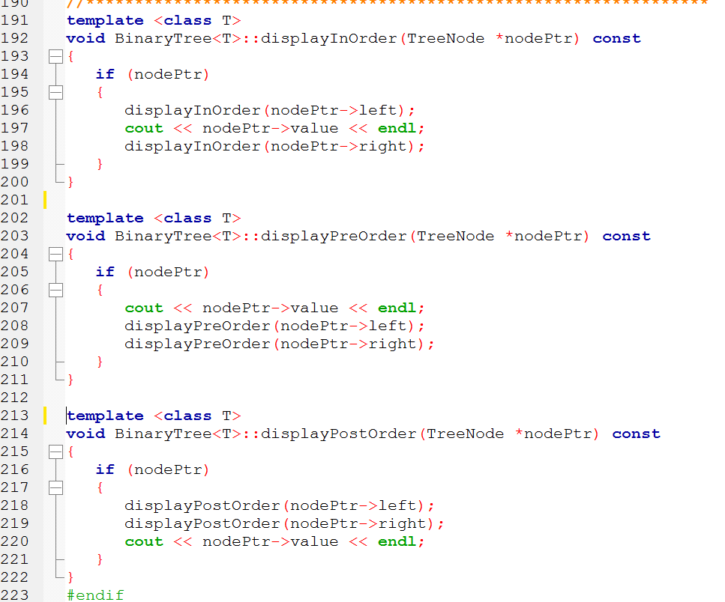
Visit left, then node, then right
Visit each node, then its children
Visit its children, then visit the node

Slide 70
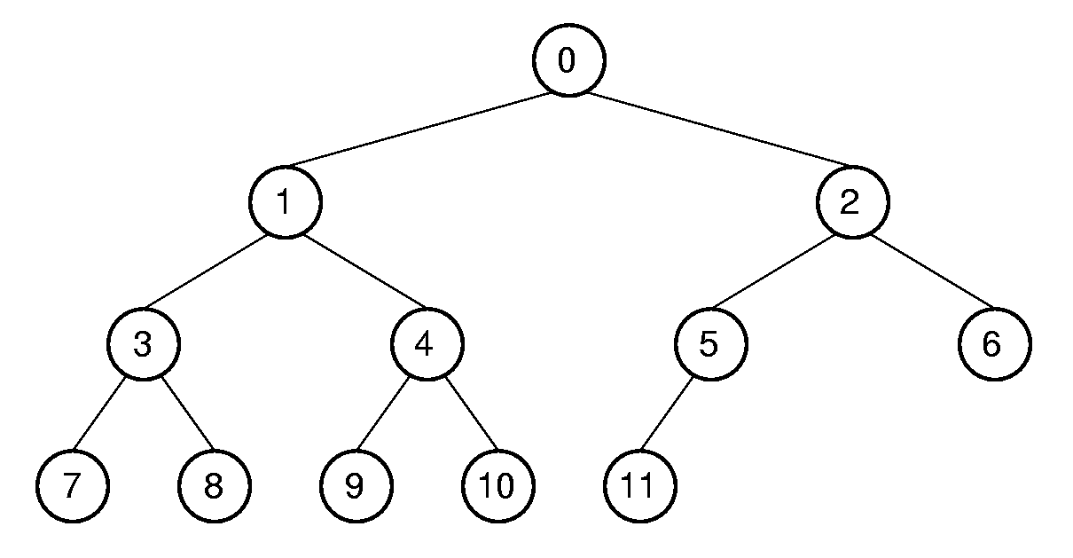
Array Implementation
Position | 0 | 1 | 2 | 3 | 4 | 5 | 6 | 7 | 8 | 9 | 10 | 11
Parent | -- | 0 | 0 | 1 | 1 | 2 | 2 | 3 | 3 | 4 | 4 | 5
Left Child | 1 | 3 | 5 | 7 | 9 | 11 | -- | -- | -- | -- | -- | --
Right Child | 2 | 4 | 6 | 8 | 10 | -- | -- | -- | -- | -- | -- | --
Left Sibling | -- | -- | 1 | -- | 3 | -- | 5 | -- | 7 | -- | 9 | --
Right Sibling | -- | 2 | -- | 4 | -- | 6 | -- | 8 | -- | 10 | -- | --

Slide 71
Array Implementation
For a complete binary tree
Parent(r)= (r-1)/2 if r <> 0 and r < n.
Leftchild(r)= 2r + 1 if 2r + 1 < n.
Rightchild(r)= 2r + 2 if 2r + 2 < n.
Leftsibling(r)= r - 1 if r is even, r > 0, and r < n.
Rightsibling(r)= r + 1 if r is odd and r + 1 < n.
0
1
2
3
4
5
6
7
8
9
10
11

Slide 72
Cost of BST Operations
Find:
Insert:
Delete:
O(n)

Slide 73
I’m split down the middle whether or not I like the Binary Tree.

Slide 74
References
Slide contributions include:
Walter Savitch, Problem solving with C++ (9th Edition). Addison-Wesley Longman Publishing Co., Inc. Boston, MA, USA ©2015
Gaddis, Starting Out with C++: From Control Structures through Objects, (8th Ed.) , Addison-Wesley Longman Publishing Co., Inc. Boston, MA, USA ©2015
Bjarne Stroustrup, The C++ Programming Language, 3rd Edition, Addison-Wesley Longman Publishing Co., Inc. Boston, MA, USA ©2007
Herb Sutter, Andrei Alexandrescu, C++ coding standards : 101 rules, guidelines, and best practices, Copyright © 2005 Pearson Education, Inc.
Paul Deitel & Harvey Deitel, C++ How to Program, (7th Ed.) © 2010 by Pearson Education, Inc.
Upper Saddle River, New Jersey 07458
Scott Meyers, Effective Modern C++. Copyright © 2015 (O’Reilly) , 978-1-491-90399-5.
Andrew Koenig and Barbara E. Moo, Accelerated C++ Practical Programming by Example,
Addison-Wesley, 2000 ISBN 0-201-70353-X

Slide 75
References
Slide contributions include:
Frank M. Carrano. Data Abstraction & Problem Solving with C++ (5th Edition)
Addison-Wesley Longman Publishing Co., Inc. Boston, MA, USA ©2006
TutorialsPoint - http://www.tutorialspoint.com/cplusplus/
Cplusplus.com - http://www.cplusplus.com/doc/tutorial/
http://www.keithschwarz.com/cs106l/fall2010/course-reader/Ch5_STLSequenceContainers.pdf

Slide 76
References
Slide contributions include:
Clifford A. Shaffer, Data Structures and Algorithm Analysis, Edition 3.2 (C++ Version) , Dover Publications, © 2009-2012
Douglas Wilhelm Harder, M.Math. LEL. https://ece.uwaterloo.ca/~dwharder/aads/Lecture_materials/
Algorithms and Data Structures, Department of Electrical and Computer Engineering University of Waterloo, 200 University Avenue West,
Waterloo, Ontario, Canada N2L 3G1 ©2006-2013
Michael Main, Walter Savitch. Data Structures and Other Objects Using C++
(4th Edition). Addison-Wesley Longman Publishing Co., Inc. Boston, MA, USA ©2010
Kurt Mehlhorn, Peter Sanders. Algorithms and Data Structures The Basic Toolbox
Springer-Verlag Berlin Heidelberg ©2008
Edition Ian H. Witten, Alistair Moffat, and Timothy C. Bell
Managing Gigabytes: Compressing and Indexing Documents and Images, Second Edition, © 1999 by Academic Press
http://www.unf.edu/~wkloster/3540/wiki_book2.pdf

